Slide 1
WELCOME TO Grade 5
TeacheR: Mrs Ly
Duong quang PRIMARY SCHOOL

Slide 4
1. LOOK, LISTEN & REPEAT.

Slide 5
1. LOOK, LISTEN & REPEAT.
What are you doing, Mary?
Don’t play with the knife!
You may cut yourself.
Ok
I am cutting the cabbage
What are you doing
with the stove?
Don’t touch the stove!
You may get a burn.
I want to cook
the cabbage.
Ok, I won’t

Slide 6
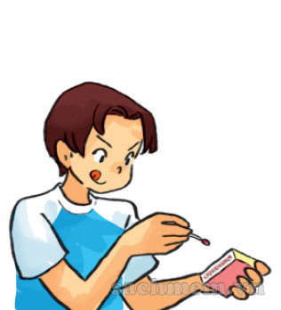
2. POINT AND SAY.
play with matches

Slide 7
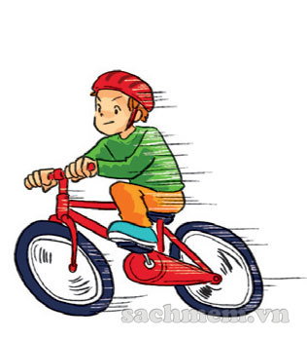
2. POINT AND SAY.
ride your bike too fast

Slide 8
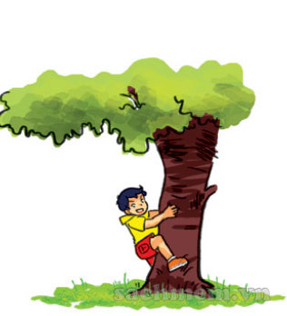
2. POINT AND SAY.
climb the tree

Slide 9
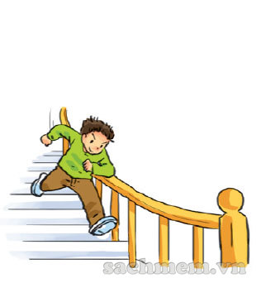
2. POINT AND SAY.
run down the stairs

Slide 10
Check up

Slide 11
2. POINT AND SAY.
Play with matches
ride your bike too fast
climb the tree
run down the stairs
play with matches

Slide 12
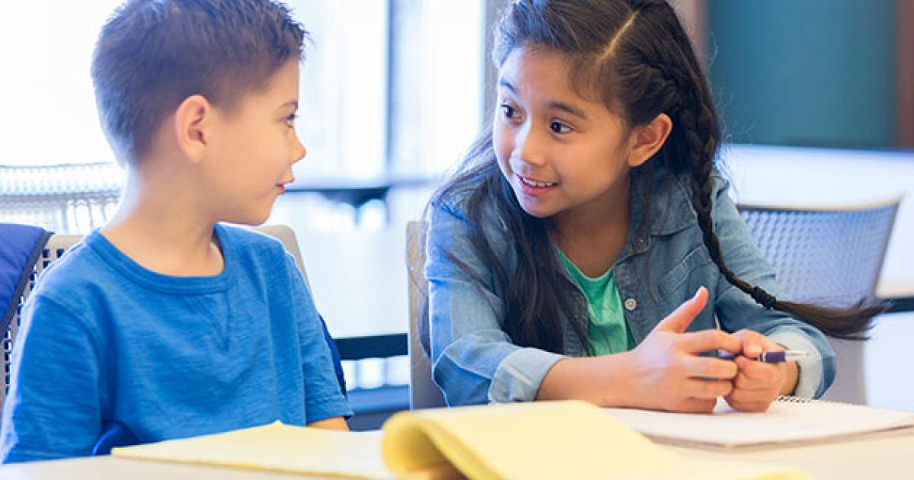
WORK IN PAIRS
Ok, I won’t !
Don’t __ !

Slide 13
2. POINT AND SAY.
Play with matches
Ride your bike too fast
Climb the tree
Run down the stairs
Play with matches

Slide 14
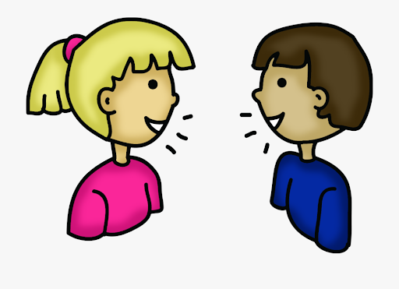
3. Let’s talk
I want to ____
What are you doing with ___?
Ok, I won’t !
Don’t _____ !

Slide 15
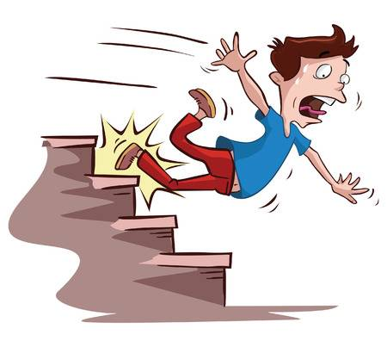
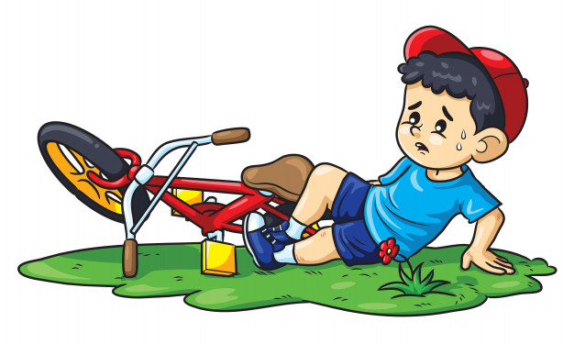
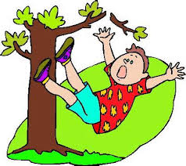
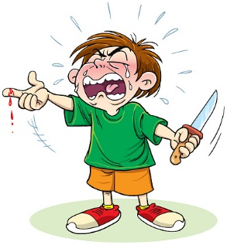
GUESSING GAME
1
2
3
4
5
6

Slide 17
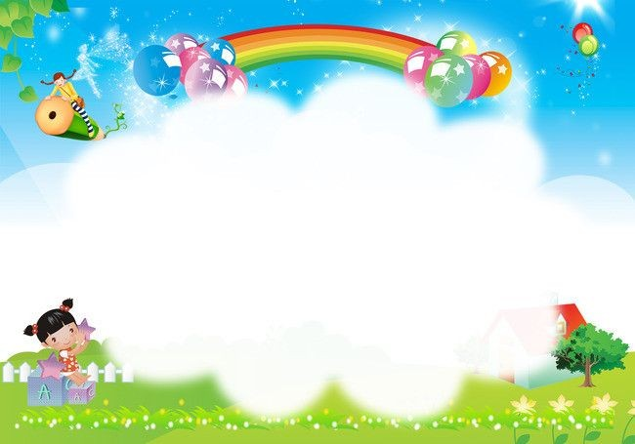
Thank you
and goodbye !

Slide 18
Review unit 12:
Don’t ride your bike too fast!
I/ Vocabulary and Grammar:
1. Vocabulary:

Slide 19
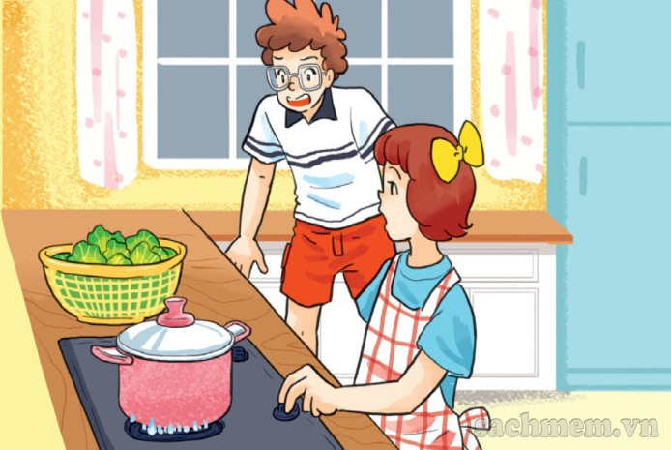
play with the knife
climb the tree
Dangerous activities
play with matches
touch the stove
run down the stairs
ride your bike too fast

Slide 20
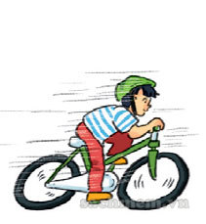
cut yourself
bad things can happen...
break your leg/arm
get a burn
fall off your bike

Slide 21
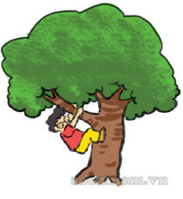
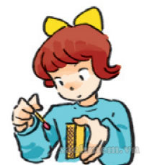
Review unit 12
2. Grammar:
Give and respond the warnings:
Don’t play with matches.
climb the tree.
Ok, I won’t.
Ask & answer about the reason
why you shouldn’t do dangerous things:
- climb the tree?
play with the knife?
cut yourself.
- Because you may break your leg.

Slide 22
Review unit 12
3. Phonics:
Listen and mark or :
Don’t play with the knife!
Ok. I won’t.
Don’t play with the knife!
Ok. I won’t.
Why shouldn’t I play with
the knife?
Because you may cut yourself.
Why shouldn’t I play with
the stove?
Because you may get a burn.

Slide 23
Review unit 12
II/ Exercises:
1. play with matches.
3. climb the tree.
2. play your bike (too fast).
4. run down the stairs.

Slide 24
cutting
with
are
himself
run

Slide 25
3. Reorder the words given to make a sentence:
1. go/ we/ barefoot?/ shouldn’t/ Why/
→ Why shouldn’t we go barefoot?
2. may happen/ when/ What/ you/ that small branch?/ climb
→ What may happen when you climb that small branch?
3. Be/ the neighbor’s/ with/ kittens!/ careful/
→ Be careful with the neighbor’s kittens!
4. may happen/ when/ What/ I play/ the sharp knife/ with/?
→ What may happen when I play with the sharp knife?

